Slide 1
Grocery Forecasting Kaggle Competition
Jia Chen | Kate Dedrick | Josh Stead | Michael Waters
Team 18

Slide 2
Competition Overview
The grocery store chain Corporacion Favorita wants a model that more accurately forecasts product sales so that they can have the right amount of inventory at the right time, reducing product waste and saving money
Our goal is to predict the unit sales for thousands of items sold at different Favorita grocery stores located in Ecuador
The available data includes dates, store and item information, unit sales, and whether items were being promoted
Solutions are evaluated using the Root Mean Squared Logarithmic Error (RMSLE) for the predicted unit sales, with perishable items having higher weights
Notes:
https://www.kaggle.com/c/favorita-grocery-sales-forecasting/overview/evaluation

Slide 3
Available Data
54 different stores in various cities, data includes cluster and type
4100 different items, grouped into broad families (Bread/Bakery, Beverages, etc.), identified as perishable or not
83,000 transactions at various stores over a 4.5 year time period (2013-2017)
Daily oil prices- Ecuador is an oil-dependent country and its economical health is highly vulnerable to shocks in oil prices
Holidays given with their dates and if it is local/regional/national
Notes:
https://www.kaggle.com/headsortails/shopping-for-insights-favorita-eda

Slide 4
Example: LGBM Model
Pros:
Light GBM: a fast, distributed, high-performance gradient boosting framework based on decision tree algorithm
Splits the tree leaf-wise with the best fit whereas other boosting algorithms split the tree depth-wise or level-wise
Cons:
Narrow scope: focused a lot on if an item was on promotion, could benefit from using additional variables
Python: this code and most other solutions were written in Python
Notes:
https://www.kaggle.com/ceshine/lgbm-starter/code
Light GBM is a fast, distributed, high-performance gradient boosting framework based on decision tree algorithm, used for ranking, classification and many other machine learning tasks.Since it is based on decision tree algorithms, it splits the tree leaf wise with the best fit whereas other boosting algorithms split the tree depth wise or level wise rather than leaf-wise.
LGBM Advantages
Faster training speed and higher efficiency: Light GBM use histogram based algorithm i.e it buckets continuous feature values into discrete bins which fasten the training procedure.
Lower memory usage: Replaces continuous values to discrete bins which result in lower memory usage.
Better accuracy than any other boosting algorithm: It produces much more complex trees by following leaf wise split approach rather than a level-wise approach which is the main factor in achieving higher accuracy. However, it can sometimes lead to overfitting which can be avoided by setting the max_depth parameter.
Compatibility with Large Datasets: It is capable of performing equally good with large datasets with a significant reduction in training time as compared to XGBOOST.

Slide 5
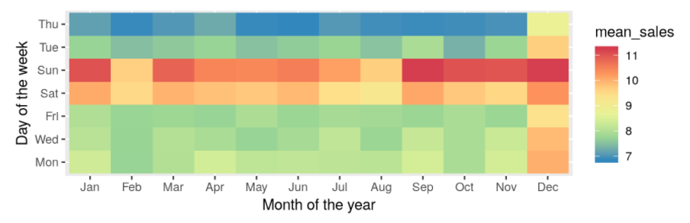
Exploratory Data Analysis: Weekday
Weekends have significantly higher average sales, Thursdays lower compared to the other weekdays
This variable is highly correlated with unit sales, so it should be included in the model
Notes:
the mean sales per day of the week vs month of the year as a heatmap
The weekday and month information, contained in the date, shows us that weekends have significantly higher average sales numbers. Thursdays, on the other hand, have consistently lower sales. Tuesdays seem to be slightly lower.
The higher level for December is most likely because of Christmas
https://www.kaggle.com/headsortails/shopping-for-insights-favorita-eda

Slide 6
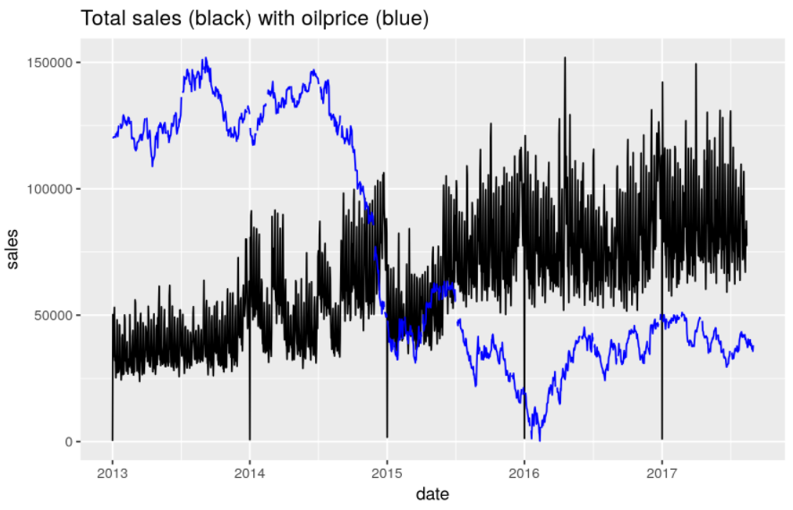
Exploratory Data Analysis: Oil Price
Over time the total oil prices decrease and the sales increase
Notes:
We find that over time the sales increase and the oil price drops. The large oil price decrease during the 2nd half of 2014 might have affected the lower sales numbers in the 1st half of 2015 (compared to the on average higher level in late 2014). Over the last year, the oil price was relatively stable.
https://www.kaggle.com/headsortails/shopping-for-insights-favorita-eda

Slide 7
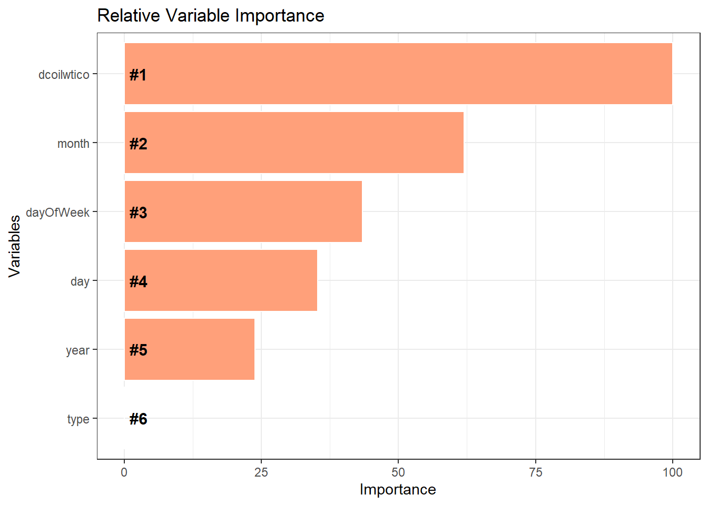
Exploratory Data Analysis: Oil Price
Oil prices are a significant factor in predicting unit sales, so we are going to include them in our model
Notes:
file:///D:/ML2/Ml2%20final%20project%2018/Corporacion-Grocery-Sales-EDA.html
Output comes from a different XGBoost model, link above

Slide 8
Our Model
Used Light GBM because of its speed and accuracy
Included more variables such as Weekday and Oil Prices

Slide 9
Reproducibility
R examples were sparse for this data set so it required creativity on our end to mend different examples into a clear vision and direction for our model.
While other models did not include oil prices in their forecasting we decided to include them due to its importance. Other models tended to be narrower in scope
The large size of the dataset made it impractical to use all of it, therefore our predictions were based off of a small subset (1%) of the available rows
The test data set provided did not include actual unit sales, so we had to create our own test set from the training data

Slide 10
Conclusions
Our inclusion of more variables of greater importance gave us a more holistic model that took other economic factors into consideration.
This was a challenging data set with many files of varying data types. There was little in the way of precedent work to help guide us but gave us a lot of opportunity to go in our own direction.

